Slide 1
The National Environmental Policy Act (NEPA)
Local Public Agency
Guide to Getting
Through
NEPA
Nick Hines, CEP
NEPA Management and Project Delivery Supervisor

Slide 2
1969 NEPA Enacted by Congress
First Major Environmental Law
Evaluate Environmental Effects
Two Major Purposes
Make Informed Decisions
Increase Citizen Involvement
Notes:
Congress enacted the National Environmental Policy Act (NEPA) in December of 1969
First Major Environmental Law in the United States
Requires Federal Agencies to evaluate the environmental effects of their proposed actions PRIOR to making final decisions.
Two Major Purposes of NEPA
Assist in making informed decisions
Increase citizen involvement in decision making

Slide 3
WYDOT Environmental Services webpage
http://www.dot.state.wy.us/home/engineering_technical_programs/environmental_services.html
FHWA Environmental Review Toolkit
https://www.environment.fhwa.dot.gov/
Code of Federal Regulations (23 CFR 771)
https://www.ecfr.gov

Slide 4
Notes:
NEPA is required on all projects that have a Federal Action.
Federal Actions can include
Federal Money - Any federal money used on the project, including pass through funding like the Transportation Alternative Program and High Risk Rural Roads.
Federal Permit - Section 404 permits (Waters of the U.S.), federal land special use permits, take permits for endangered species, etc
Federal Land - Use of federal land, crossing federal land, federal land use changes, etc.
The Federal Highways Administration (FHWA) is the lead agency on most WYDOT projects, including pass through funding projects

Slide 5
Notes:
NEPA has three levels of documentation – The highest is the Environmental Impact Statement or EIS. This is for projects that are known to have a significant impact on the natural or human environment. The middle level is the Environmental Impact Statement or EA. This is appropriate when you are unsure if your action will have a significant impact. The lowest is the Categorical Exclusion or CE.
LPA projects should have minimal environmental impacts and therefore qualify for a Categorical Exclusion. Chances are if your project requires an EIS or EA, it will not be funded by a TAP grant. This level of documentation usually has a larger cost associated.
Categorical Exclusions are projects that have no significant environmental impacts, based on context and intensity.
Due to the Federal DOT money that is paying for the grants. FHWA is the lead federal agency on the LPA projects with WYDOT providing NEPA oversight. This allows the LPA projects to fall under the Programmatic Agreement for Categorical Exclusions between FHWA and WYDOT.
In order to simplfy the NEPA process WYDOT and FHWA have agreeded to a modified CE template for local agencies. This LPA CE Template allows the locals to comply with federal regualtions and is a modified versions of a WYDOT CE. This CE template was created to allow ocal agency personell to complete the NEPA document with guidance from WYDOT. WYDOT is available to help answer questions, review the document and approve the document in most cases. FHWA provides WYDOT oversight and approval, if needed.

Slide 6
CE1-Batched
CE2-WYDOT Approved
CE3-FHWA Approved
Notes:
FHWA and WYDOT have developed a Programmatic Agreement for the Approval of Categorical Exclusions (CEs) for transportation projects, which outlines the procedures for the processing of CEs for federal-aid actions.
The agreement sets thresholds and if any of those are exceeded then it bumps up the CE.
MOA covers three types of CEs – CE1 (Batched), CE2 – WYDOT Approved, CE3 – FHWA approved.
You do not have to worry about what type to use.

Slide 7
http://www.dot.state.wy.us/home/engineering_technical_programs/environmental_services/LPA.html
Notes:
Make sure you are using the most current form.
Can get it from the WYDOT Environmental Services LPA page at the link above or from your LPA project manager.
DO NOT modify the CE form and do not send in any other format.
Local Agencies – review this form. If you think you can fill it out yourself then there is no need to hire a consultant to fill this form out for you. If you have questions or can not do a specific part, let WYDOT know and we can get you in touch with environmental consulants.

Slide 8
U.S. Army Corps of Engineers
U.S. Fish and Wildlife Services
Wyoming Game and Fish
WYDOT Environmental Services
Notes:
Must Send scoping letters to:
U.S. Army Corps of Engineers (USACE)
U.S. Fish and Wildlife Service (USFWS)
Wyoming Game and Fish (WGFD)
WYDOT Environmental Services - for cultural determination
DO NOT send the State Historic Preservation Office (SHPO) a scoping letter.
Contact WYDOT Environmental Services a to determine the level of Cultural Investigation needed for your project.
WYDOT will make a determination of impacts and consult with SHPO for you.
Expect a couple weeks for WYDOT to make a determination or inform you a investigation is needed. WYDOT may request GIS shapefiles from you. SHPO has a new format and all projects require a shapefile.
Expect a minimum of 30 days to get a response from SHPO.

Slide 9
Local Floodplain Coordinator
U.S. Bureau of Land Management
U.S. Forest Service
Natural Resources Conservation Svc.
Tribal Coordination
Local landowners
Notes:
Additional agencies you may have to scope depending on project location/type.

Slide 10
Project City, State and
County
Description of Work
Location of Work
Maps or Plans Showing
Location and Proposed
Improvements
(the LGS Office has example letters)
Notes:
The intent of the scoping letter is to get information and/or concerns from the agencies that oversee specific resources.
These agencies typically have no idea about your project. So you need to include enough information so they can find your project in their systems.
At a minimum you need to include the project location - Project City, State, County – for example Casper, Natrona County, Wyoming.
A Description of the proposed work – Construct a 10’ separated concrete pathway and all other work or ground disturbances your project may have.
A location of the proposed work for example Between Main Street and Third on the east side of Lincoln Street.
Maps or Plans showing location and proposed improvements are extrememly helpful and typically a requirement.
Contact the LGC office has example scoping letters you can use.

Slide 11
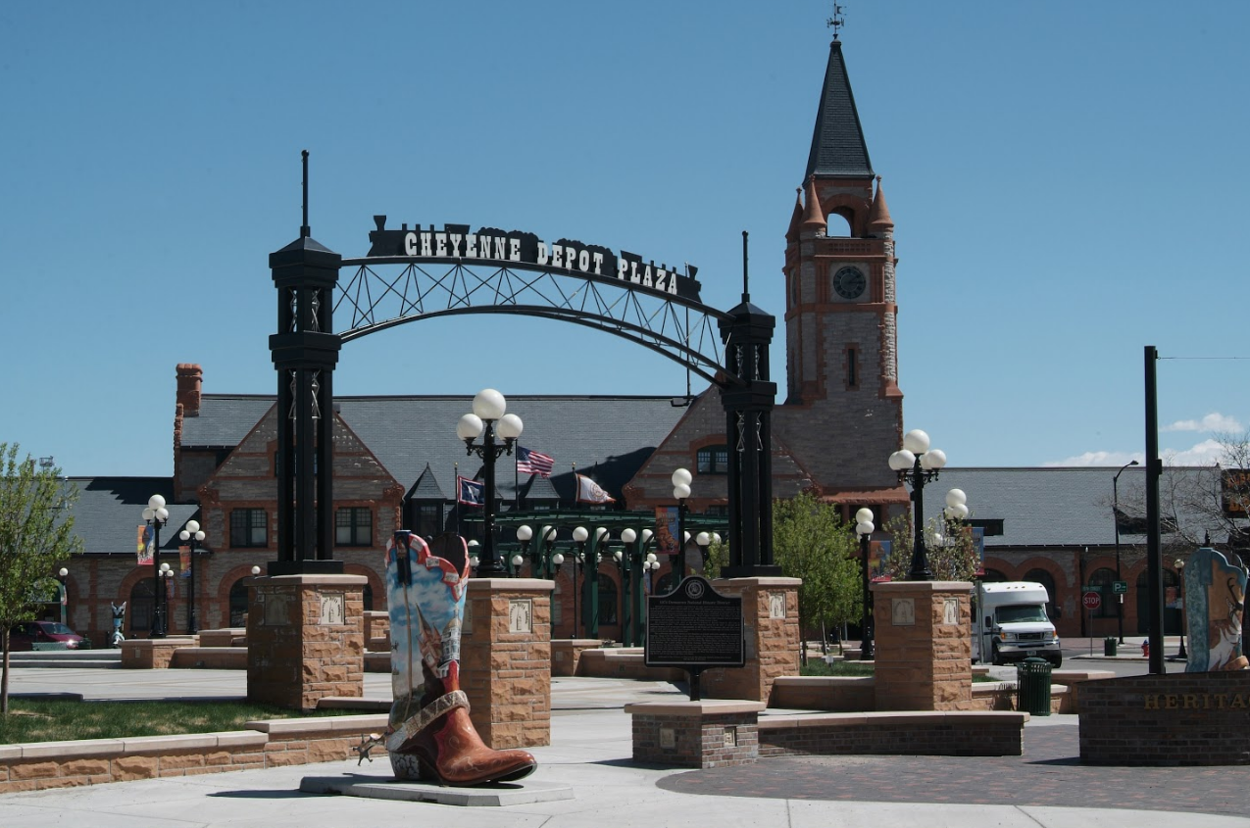
Determinations of the Area of Potential Effect, level of cultural investigation and determinations of eligibility are all made by the lead federal agency per 36 CFR 800.
FHWA is the lead federal agency and has designated WYDOT to make these determinations.

Slide 12
WYDOT will review the project based on the information provided in the scoping letter and ask “Is there a potential to affect historical properties?”
NO
YES
No Potential to Affect Historic properties
Potential to Affect Historic properties
WYDOT will send language to put in the CE and include both letters in the CE.
WYDOT will respond that a consultant will be required to produce a report
A consultant will be required to perform a Cultural or Historical survey and prepare a draft report.
Notes:
Again WYDOT may request a GIS shapefile from you for us to complete the consultation.
The shapefile is typically a polygon around your project limits and any other disturbance you may have.
All consultations require a GIS shapefile. The reason I say WYDOT may require it depends on a few things, like current work load and availability of our GIS person and complexity of your project.

Slide 13
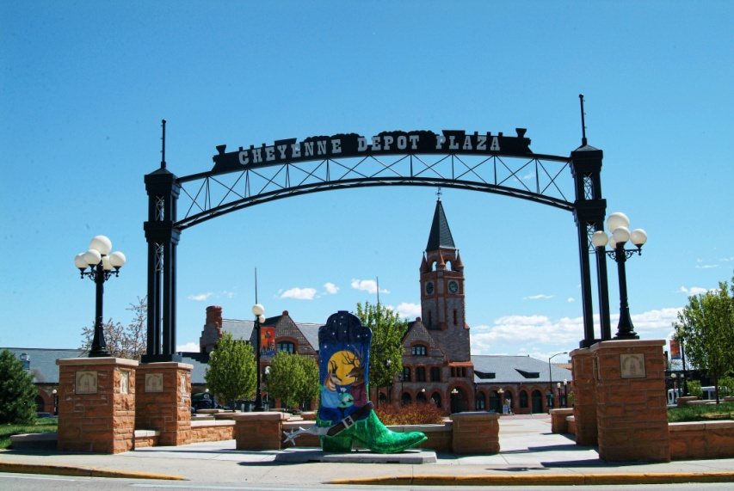
WYDOT will review the project based on the information provided in the scoping letter and ask “Is there a potential to affect historical properties?”
YES
Consultant/LPA will SEND A DRAFT report of their findings to WYDOT for review and comment.
WYDOT will make a determination and will consult with SHPO.
Once the SHPO concurrence letter is received WYDOT will send language to put in the CE. Include letters in the CE.

Slide 14
Describe any opportunities that the public has had to provide comments on the project. Include any public meetings, council meetings or direct landowner contact.
WYDOT’s current Public Involvement Handbook can be found on the WYDOT website.
http://www.dot.state.wy.us/home/news_info/public_involvement.html
Notes:
As you saw on the first page public participation is an important aspect of NEPA.
Typically all of these TAP projects have been discussed at a City, Town, or County Council Meeting. Just want you to document that in this section.
Another for of public participation is Planning document. If you are putting in a pathway and it is part of a planning document you should mention that in the CE.

Slide 15
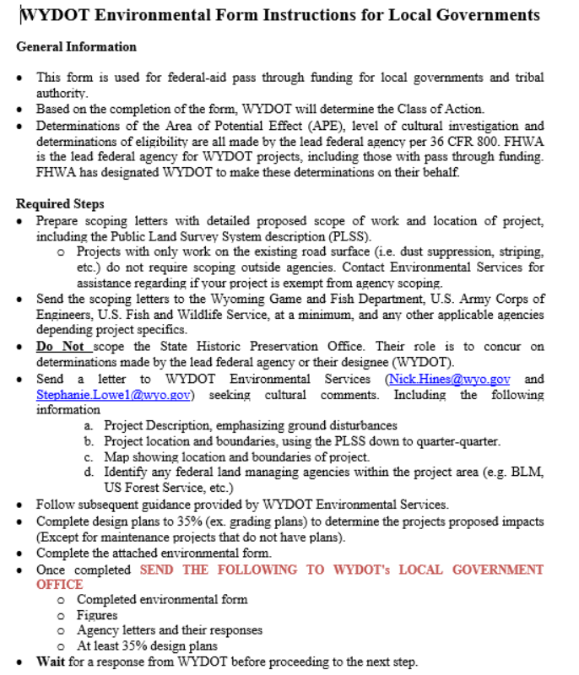

Slide 16
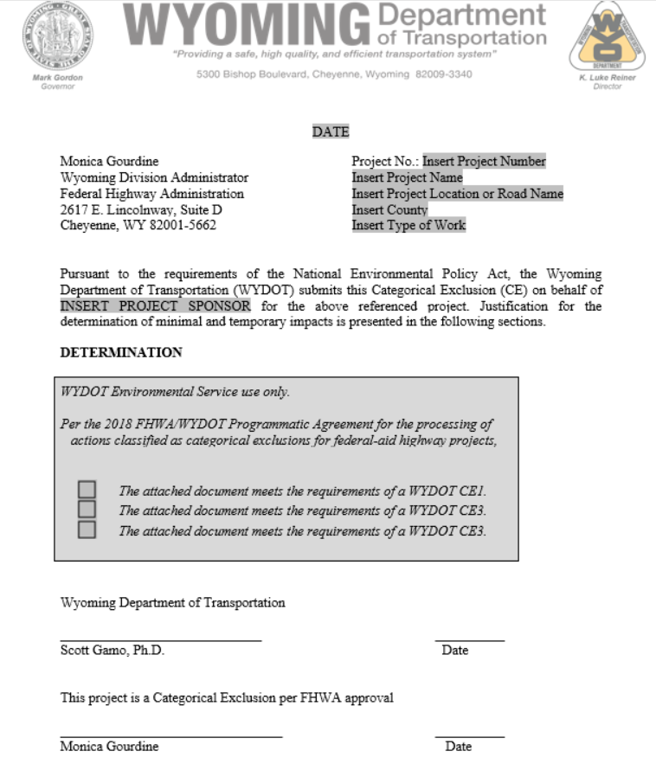

Slide 17
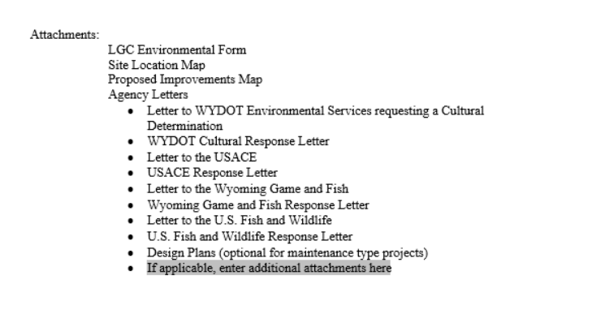

Slide 18
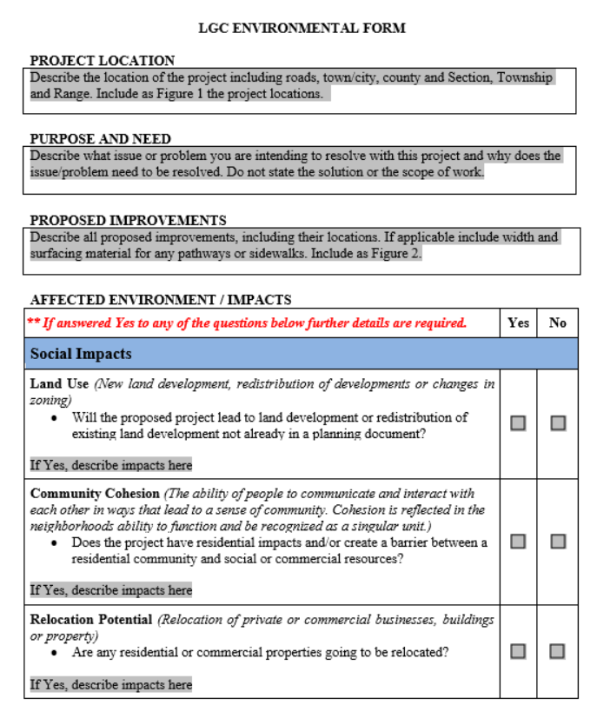

Slide 19
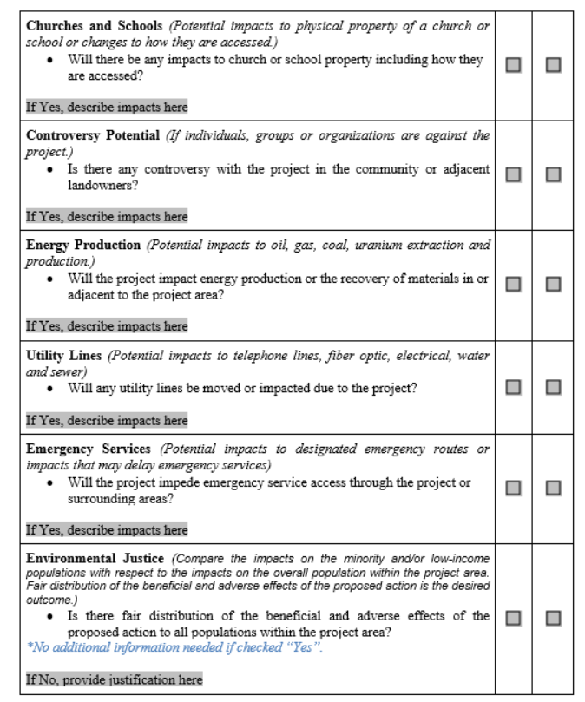

Slide 20
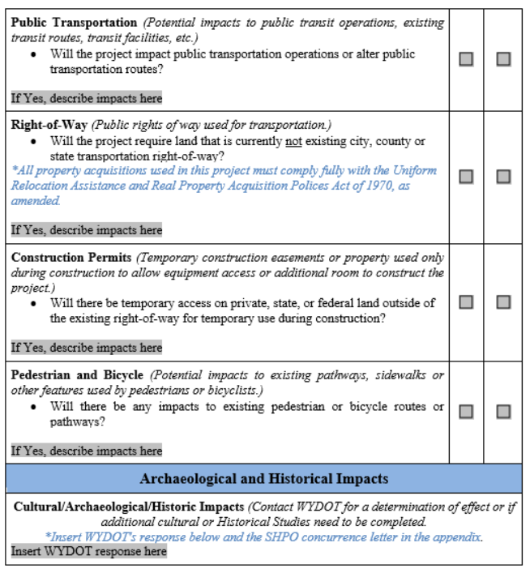

Slide 21
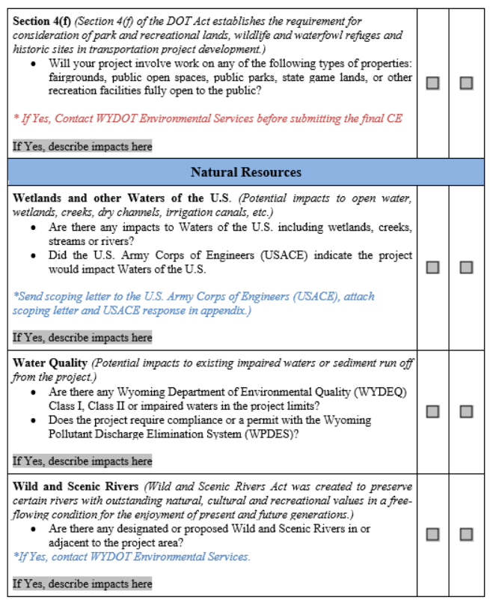

Slide 22
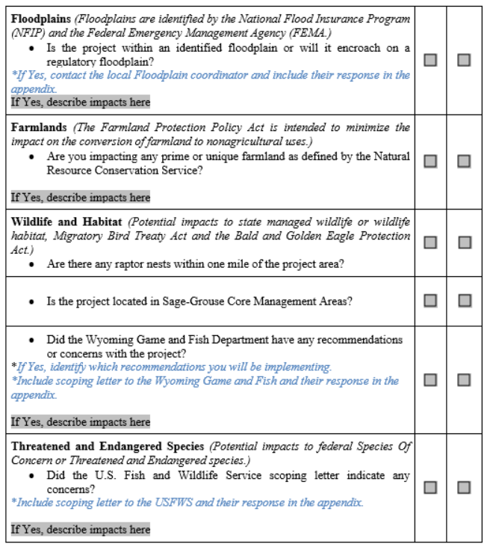

Slide 23
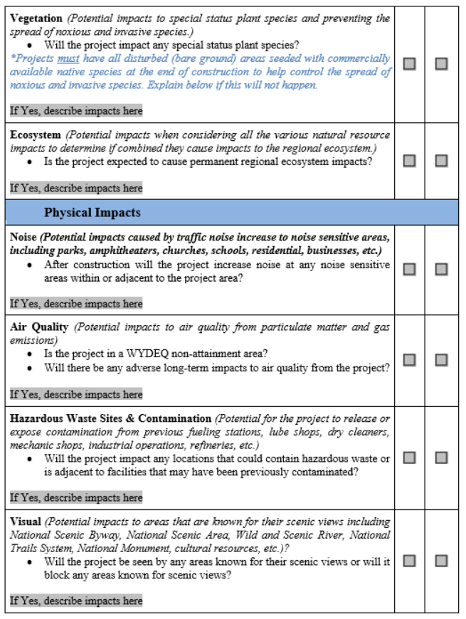

Slide 24
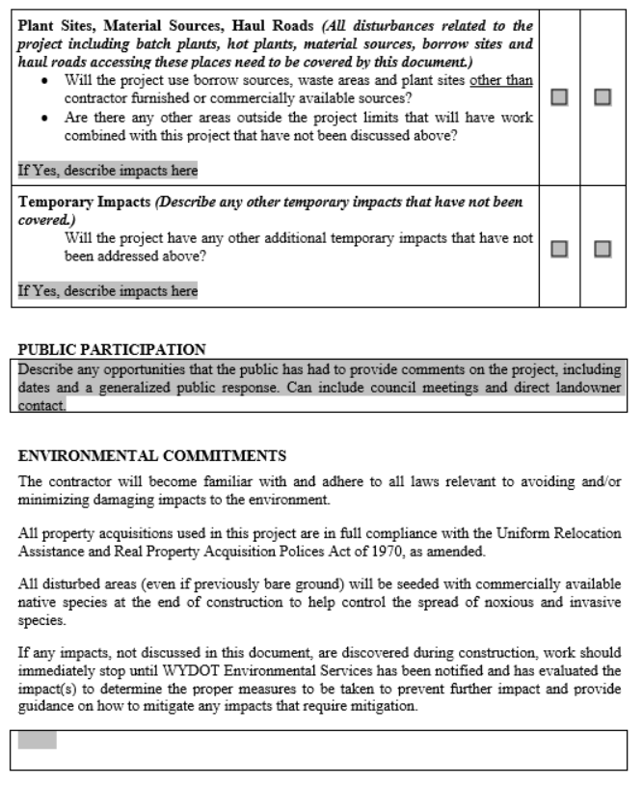

Slide 25
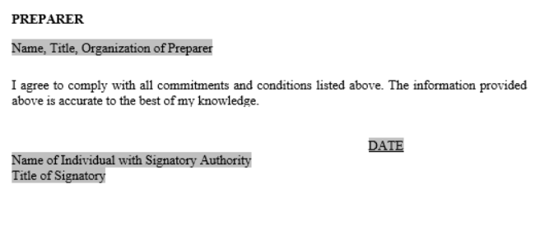

Slide 26
Questions

